Slide 1

Enterprise Function
Robert Fogel
Key Objectives, Metrics and Milestones

Slide 2

Enterprise Focus Areas
Enterprise Adoption (Cheryl Doninger)
  Help Enterprises adopt currently available Grid technology
  Enterprise awareness, education and outreach
Best Practices (Nick Werstiuk)
  Capture existing best practices to help end-users today apply currently available Grid technology
Enterprise Requirements (Robert Cohen and Ravi Subramaniam)
  Influence OGF standards to comprehend the needs of enterprise & eScience end uses
  Work with the OGF standards to focus on requirements that are both relevant to OGF and relevant to enterprise & eScience
Vendor & Developer Adoption (Craig Lee)
  Help Vendor & Developer adopt and apply OGF standards via outreach, awareness and education
  Influence OGF standards to comprehend vendor & developer’s economic factors of adoption
Market Research (Bob Cohen)
  Satisfaction surveys
  Industry trends and landscape
Enterprise PM: Gwen Nichols-White

Slide 3
Enterprise End Users
Technical
  System administrators, line of business application developers
  Researchers who use technology to actually do research
Business Technical
  CTOs, CIOs and IT architects
  Technology decision makers and leadership
  Use technology to solve a business problem
Business
  CEOs, CFOs and general business-level (i.e. not technical)
  Make funding decisions to solve a business problem

Slide 4
Enterprise Adoption
Objectives:
  Enterprise Adoption track/sessions at OGF events
  OGF enterprise presence at external (i.e. non-OGF hosted or partnered) events.
  Create a web presence via OGF website
  Develop content for web-accessible content library
  Determine high-priority adoption candidates
Success Metrics:
  Growth and participation of the OGF enterprise community
  Press/analysts references
  High satisfaction rating from the OGF enterprise community
Timeline:
  OGF19: BoF to brain storm Enterprise Adoption plan
  OGF20: Workshop sessions to finalize plan
  OGF21: Execute 1st phase of Enterprise Adoption plan (GridWorld-type outreach)

Slide 5
Best Practices
Objectives:
  Produce Best Practices documents and make available via the web
  Organize OGF workshops, BoFs to identify best practice topics
  Create OGF groups to develop best practice documents
  Use existing OGF docs/specs to develop best practices
  Coordinate with the Enterprise Requirements focus area and OGF Standards Function as requirements source and temporary standards workaround
Success Metrics:
  Growth of Best Practices relative to the number of problems identified
  Web site hits and reads of actual Best Practice documents
  Application and testimonial of Best Practices by end users
  Satisfaction rating from the OGF enterprise community about the usefulness and timeliness of Best Practice documents
Timeline:
  OGF19: BoF to brain storm Best Practice topics identifying top 3 Best Practice to capture
  OGF20: Workshops to finalize 1st Best Practice doc
  OGF21: Workshops to develop and finalize remaining 2 Best Practice docs

Slide 6
Enterprise Requirements
Objectives:
  Capture requirements from the Enterprise and eScience community
  Establish individual requirements groups to discuss and capture requirements
  Communicate to Enterprise and eScience community the requirements that OGF already comprehends as documented by the TSC roadmap
  Build and maintain a web accessible requirements repository
Success Metrics:
  Growth and participation in determining Enterprise requirements
  Degree of integration of Enterprise requirements into OGF standards efforts
  Satisfaction rating from the OGF enterprise community about how enterprise community is being represented in OGF Standards effort
Timeline:
  OGF18: Enterprise Requirements track (established and continue for future events)
  OGF19: Determine top-of-line requirements and determine alignment gaps with the requirements that OGF is currently addressing
  OGF20:Promote was has been done for Job Submission and Data Management
  Publish/communicate OGF response to requirements gaps

Slide 7
Vendor & Developer Adoption
Objectives:
  Provide a forum for vendors & developers to discuss and capture issues related to the adoption of OGF specifications
  Provide a forum to help vendors & developers implement OGF specifications
  Communicate to vendors & developers issues related to the adoption of OGF specifications that are already comprehended by OGF specifications
  Build and maintain a web accessible repository of vendor & developer issues
  Determine high-priority adoption candidates
Success Metrics:
  Adoption rate of OGF standards across the Grid vendor & develpoers
  Degree of participation of vendors & developers
  Degree of integration of Vendor & Developer input into OGF standards efforts
  Satisfaction rating from the OGF Vendor & Developer community about how well that they are represented
Timeline:
  OGF19: BoF to brain storm brain storm top-of-line adoption issues
  OGF20: Promote was has been done already to address vendor adoption
  OGF21: Execute plan to close gaps

Slide 8

Requirements/Standards Context Diagram
Requirements
Solicitation
Best Practice
Workshops
Standards
Groups
EGR-RG
Best
Practices
Best Practices
Applications
Req
Req
SN-CG
Architecture
Requirements
Rollup, Analysis
&
Prioritization
(EGR-RG)
Financial
TSC
GAP Analysis
Compute
Telco
Req
Prioritized Req and Req Patterns
Data
Pharma
Infrastructure
Req and Req Patterns
What WGs are doing i.e. WG roadmap
EDA
Management
Overall standards roadmap
Gap analysis of WG roadmap vs. prioritized Req
Recommended actions
Security
Vendors
Requirements
Specs

Slide 9
TSC Gap Closure Recommendations
Condition | Recommended Action
UC covered by an existing OGF WG/spec(s) | This is more of a communication issue, so attend existing group and communicate UC/spec association
UC is not covered by an existing OGF WG/spec | UC out of scope for OGF so no action Form a new Standards WG to create a specification Change the scope of existing WG Use Best Practice as an interim solutions (during standards development) “Open Letter” to the vendor/developer community to implement Handoff to another org

Slide 10
OGF Requirements Track
This is a plenary session for all persons involved in the requirements track
Explain what “Grid” is in terms of the key requirements that OGF is currently addressing
Direct requirements groups to evaluate relevance of OGF requirements relative to the individual needs of each group
Orientation
Session
Requirements Group Sessions
(Pharma, Finance, Vendor Adoption, SN-CG, EGR-RG, etc.
Individual requirements group sessions to determine how relevant are the requirements that OGF is currently addressing
Rollup results from individual requirements groups and be able report-out on relevance of requirements that OGF is currently addressing
Rollup
&
Prioritization
Report-out on alignment gap of the requirements that OGF is currently addressing and the possible gap closure recommendations
Set expectation for timeline of gap closures
TSC
Report-Out

Slide 11
Requirements & Standards Alignment
Promote requirements that OGF is already addressing | WIN-WIN!!
 | Steer OGF standards to be more relevant to the enterprise
Relevance to Enterprise
Relevance to OGF

Slide 12
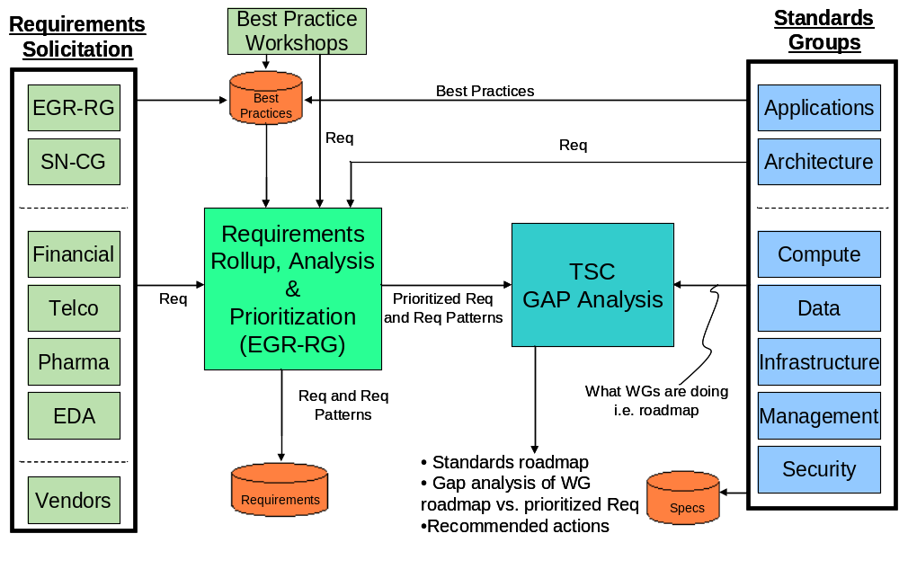
Overall Context Diagram
Enterprise
Requirements
Vendor
Adoption
Enterprises
Use
Grid Technology
Vendors & Dev
Implement
OGF Specifications

Slide 13
BACKUP

